Slide 1
Estimating R0 from epidemic data
Cristina Lanzas and Shi Chen
CBS 810 Infectious disease modeling
Notes:
We know how to “simulate” a model by a set of specific parameters – then we know R0. But most of the time we are faced with the observation. These are two opposite processes, but closely related.
Inference: estimate parameters from observation (data)
Similar: regression (estimate slope and intercept) from given data.

Slide 2
Basic reproduction number
Basic reproduction number (R₀):
Expected number of cases caused by a typical infectious individual in a susceptible population.
R0 ≤ 1
disease dies out
R0 > 1
disease can invade
POPULATION SPECIFIC MEASURE
Notes:
Recap of R0：the critical threshold value of 1.
Coin (R0<1 -> system stochasticity)

Slide 3
Effective reproduction number
Transmission
No transmission
Immune
Effective reproductive number
Expected number of cases caused by a typical infectious individual
in a population that is not wholly susceptible.
Notes:
More realistic: not all individuals are susceptible -> what is the implication (e.g. vaccination?)

Slide 4
Numerical values of the basic reproduction number and the critical vaccination proportion, pc
Scherer, A. & McLean, A. Mathematical models of vaccination. Br Med Bull 62, 187-199 (2002).
Notes:
Relationship between R0 and critical vaccination:
Pc=1/(1-R0)
Intuitively: the more “infectious”, i.e., larger R0, the more vaccination coverage we need to provide.

Slide 5
Why do we estimate R₀
Metric for public health guidance
Risk of an epidemic in emerging infectious disease
Epidemic threshold
Critical vaccination threshold
Threshold values for other control measures
Notes:
Especially important for public health (PH): decision-making, intervention, etc.

Slide 6
Ebola-Guinea (2014)
Notes:
Transition between endemic and epidemic phases.

Slide 7
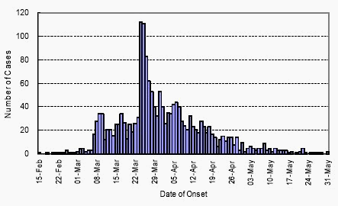
SARS-Hong Kong (2003)
Notes:
Isolated for two month

Slide 8
Methods for epidemic data
Intrinsic growth rate
Final size epidemic
Model fitting
Notes:
Some analytical methods 1-2.

Slide 9
Intrinsic growth rate
The number of infectious disease individuals in the early phase follows an exponential growth:
lnI_{t} = lnI₀+Λt
Notes:
For simple epidemic SIR model
R0: one initial infected, entirely/completely susceptible population. So for N is very large we can write S=N. Now note that beta, N, and gamma are ALL constants/parameters, we can rearrange it.

Slide 10
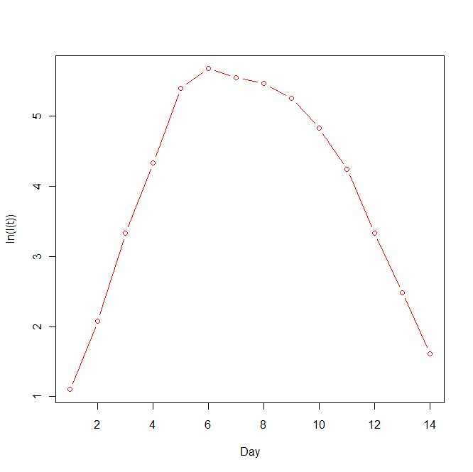
Natural log (I(t))
ln(I(t)) = ln(I(0))+Λt
Notes:
Only valid for initial phase (S=N) or I<<N
Log transormation does not change the shape.

Slide 11
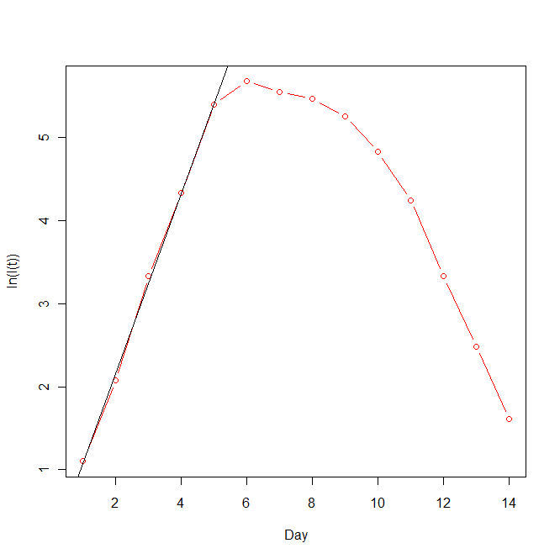
Notes:
Fit a straight line (using simple linear regression SLR)

Slide 12



Intrinsic growth rate and basic reproduction number
$$\frac{dI}{dt}=\left(βS−γ\right)I \sim \left(βN−γ\right)I\sim ΛI$$
$$\left(βN−γ\right)=Λ$$
R₀ = $\frac{βN}{γ}$
R₀ = 1+ $\frac{Λ}{γ}$
R₀ = 1+ ΛD
Notes:
D is infectious period. Reciprocal/inverse of the recovery rate. (Emphasize again)

Slide 13
Limitations of using the intrinsic growth rate to estimate R₀
Stochastic fluctuations in the early phase of an epidemic complicate the estimation of the intrinsic growth rate
Reporting inaccuracies can bias the incidence data. If the proportion of cases in the population who are reported increases over time (e.g. increase self-reporting as individuals become aware of the infection), the intrinsic growth rate (and R₀) may be over predicted.
The relationship between the intrinsic growth rate and R₀ are highly influenced by the assumptions and assumed model.
Notes:
“Stochastic” first encounter of this word – will emphasize on it later.
Advantage: only needs a few initial data (but wait… that can be dangerous!)

Slide 14
R0 and intrinsic growth rate: model dependency
S
I
R
SIR epidemic model
S
I
R
SIR epidemic model with disease-induced mortality
S
I
R
SIR with demography and disease-induced mortality
Notes:
Different model structure will lead to different estimations of R0.

Slide 15
Final size equation
Notes:
Advantage: only needs two data points
Disadvantage: need to confirm the final size

